Slide 1
INLS 641 NYC Airbnb Visualization Project Presentation
Suchi Parekh, Yuan Wen, Cody(Yuxuan) Xu, Rui Hou

Slide 2
Presentation Outline
Conclusion
01
Introduction to the data and research questions
05
02
Our process to develop solution design
Live Demo
04
03
Our final design

Slide 3
Research Questions
Which neighborhoods in NYC are popular for Airbnb service?
Which neighborhood has more available rooms for listing?
What are the average prices of these neighborhoods? Which areas are pricier compared to others?
Which room types are booked more frequently?
Do people have preference for short term or long term stay in NYC?
Notes:
Our project is about analyzing Airbnb data for the New York city and gather insights about the price and popularity of different areas of NYC.
This project proposes to answer these questions:
1) So,Before making the travel bookings, it is always helpful to find out which areas are more popular in the city that we are visiting. Therefore, we have created visualizations which provides that information.
2) Similarly it also helpful to have the information about prices of different areas.
3) And We will also show which room types are more in demand and booked more than others and in which area.

Slide 4

Tasks
Price Trends
Popularity Trends
Listings Availability
Notes:
The main purpose of this project is to enable travellers take the best decisions before finalising their bookings. Another aim is to allow the information science students and researchers to study the travel trends.
For that user can explore Price trends and popularity trends.
Price Trends
One of the most important aspects while planning a trip is the budget. People have a certain budget in their mind and they would like to find out the areas which would meet their budget expectations. Therefore, we will first present an area wise price trends to the users using which they can take their decisions.
Popularity Trends
Another important aspect while planning a trip is the popularity of an area. People like to visit the popular places or areas during their trips. Therefore, along with the prices trend, we would like to present the popular areas and listings also to the users using which they can make their best decision.

Slide 5

Dataset from Kaggle
https://www.kaggle.com/dgomonov/new-york-city-airbnb-open-data
Notes:
48.9K records of 16 fields
Location metrics (latitude and longitude)
price
number_of_reviews
Room_type
Reviews_per_month
Availability_365
For data cleaning and preparation, we used Python and pandas.
- We had missing data for some of the fields like … last_review, reviews_per_month, name and host_name.
- We are anyways not going to use name, host_name based on our current plan so it will not impact our data analysis.
- For reviews_per_month, and last review, we considered the null values as 0.

Slide 6
Raw dataset eg. listing ID, host_name, neighbourhood_group, latitude…
Pick up some of the fields, based on our objectives.
Process to Develop Solution Design
Notes:
Based on our current objectives, we focus on exploring prices in different areas, number of rooms, availability and popularity, which can give users direct insight into the Airbnb in NYC.
Therefore, we don’t have to use all the fields listed in the raw dataset. We choose some representative fields and analyze the data for visualization.
Our overall process was to brainstorm together for every objective and to come to the best solution that we could think of.

Slide 7
Objective 1: Price in all locations
Fields: “latitude”, “longitude”, “price”, “room_type”, “neighbourhood_group”
Visualization: Scatter Plot, color_coded range
Process to Develop Solution Design
Notes:
Firstly, one important factor for customers to choose lodges is the price in different areas. So, we decide to use the columns “latitude”, “longitude”, “price”, “room_type”, “neighborhood_group” to draw a scatter plot. The longitude and latitude points will visualize all NYC listings distinguished with different prices, room types and neighborhoods. Then a color-coded range for each point on the map is added based on the prices of listings.

Slide 8
Objective 2: Price in five neighborhood areas- Brooklyn, Manhattan, Queens, Staten Island, Bronx
Fields: “price”, “neighbourhood_group”
Visualization: Violin Plot: show density and distribution of prices in the five neighborhood groups
Fields: “minimum_nights”, “id”
Visualization: Histogram: show number of short term/long term rooms
Process to Develop Solution Design
Notes:
In addition to the scatter plot which visualizes all locations in NYC, it’s also necessary to show details for five neighborhood groups- Brooklyn, Manhattan, Queens, Staten Island, Bronx.
So, we choose columns “price” and “neighborhood_group” to draw a violin plot which shows density and distribution of prices in the five neighborhood groups; then use columns “minimum_nights”, “id” to draw a histogram to visualize number of short term/long term rooms in the five neighborhood groups.

Slide 9
Objective 3: details for availability and popularity of the 200 neighborhoods
Fields: “availability_365”, “neighbourhood”
Visualization: Bar Chart: calculate average available days in a year for every neighborhood; show the number of rooms for every neighborhood.
Process to Develop Solution Design
Notes:
According to the raw dataset, there are nearly 200 neighborhoods in total. For the further step, to provide details for the availability and popularity of the 200 neighborhoods, we choose columns “neighborhood” and “availability_365” to design a bar chart with two attributes. The first attribute is to calculate average available days in a year for every neighborhood. The second attribute is to show the number of rooms for every neighborhood.

Slide 10
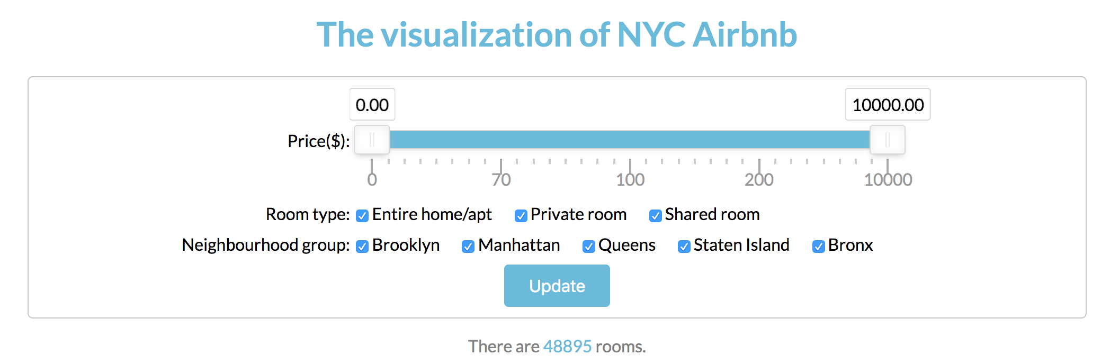
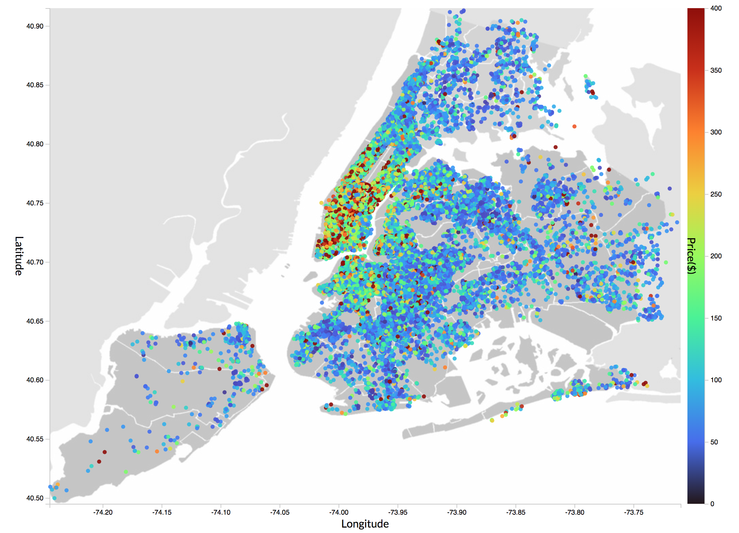

Slide 11
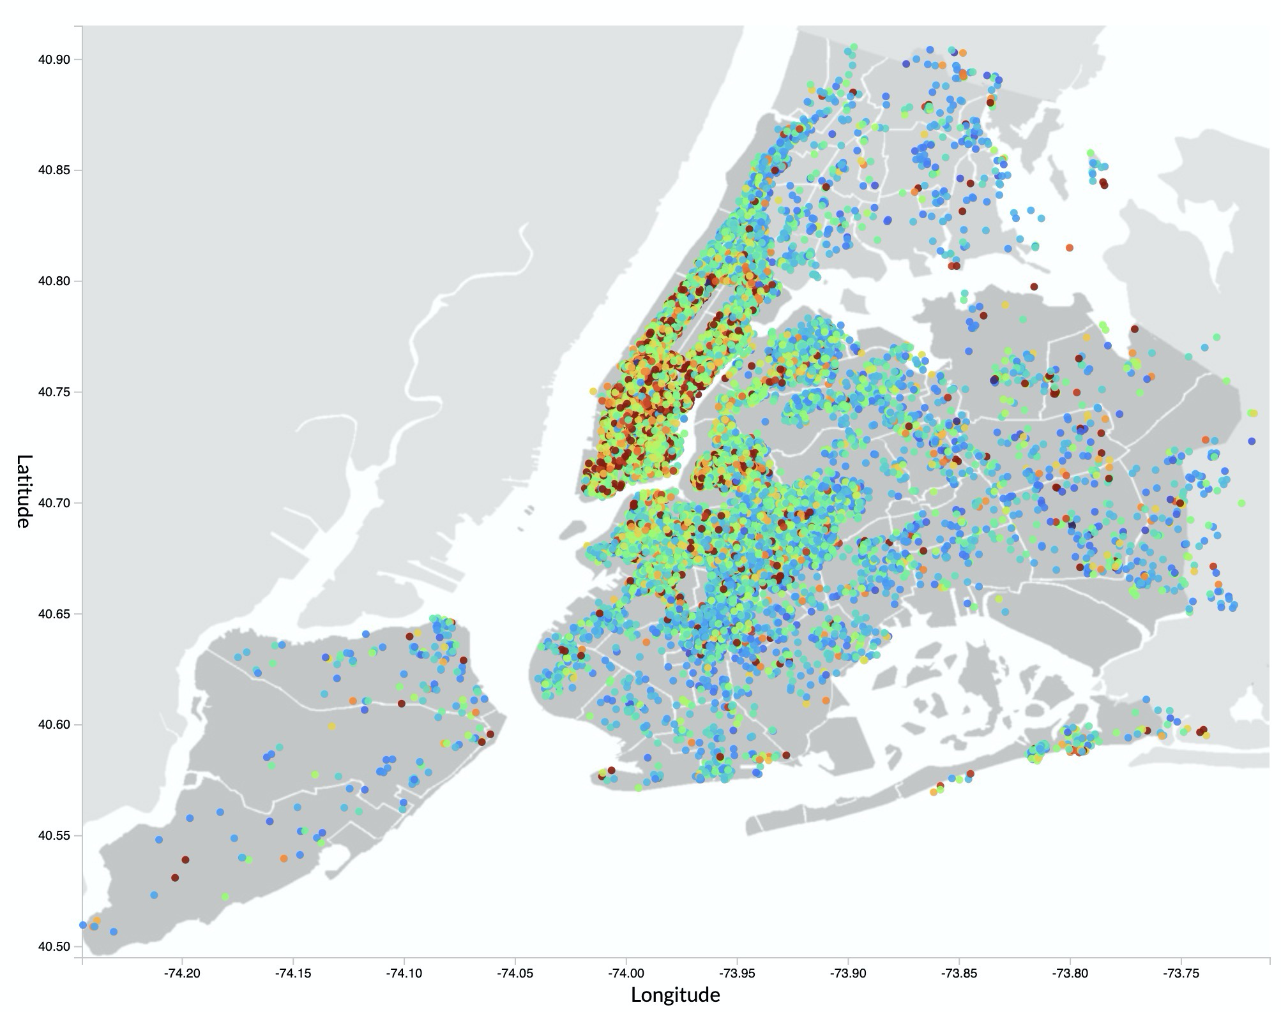
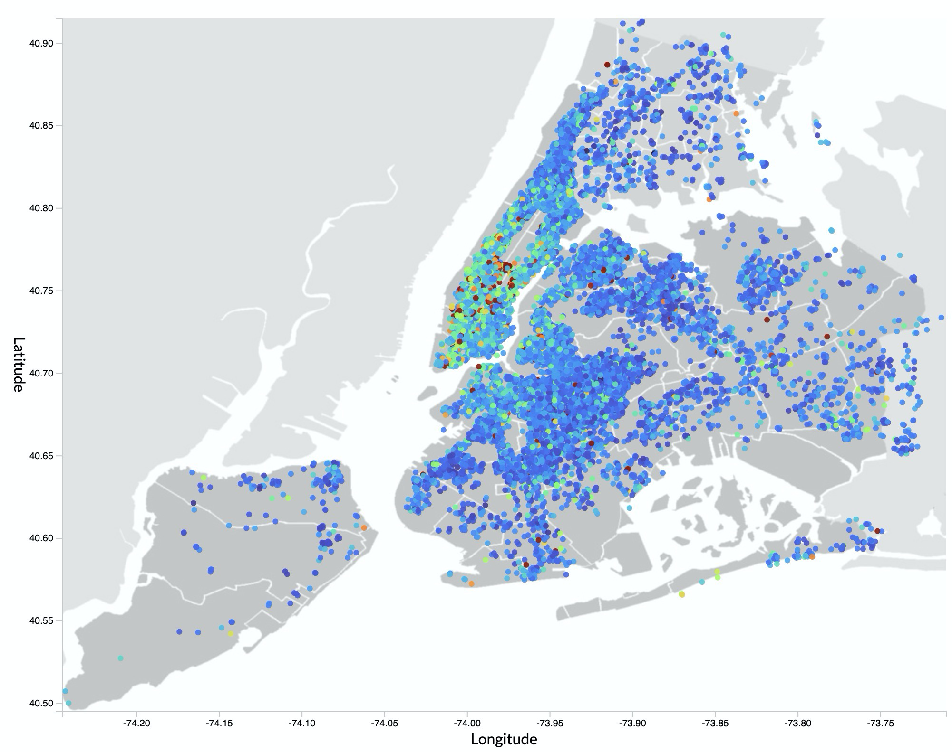
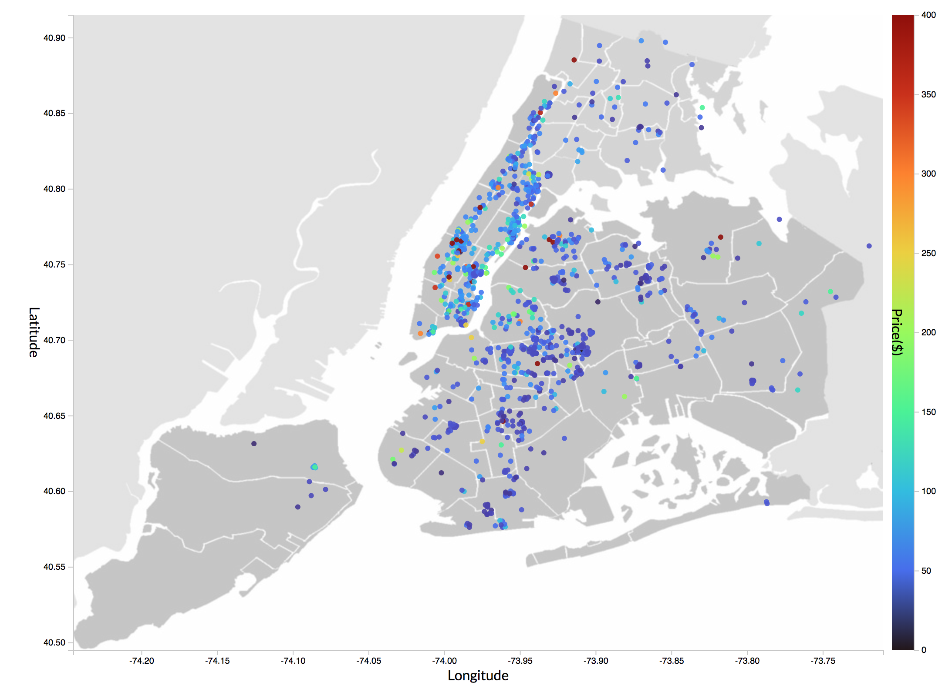
Entire Apartment vs. Private Room
Entire Apt: 25409 listings
Private Room: 22326 listings
Shared Room: 1160 listings
Notes:
Total: 48895
Entire apt: 25409
Private room: 22326
Shared room: 1160

Slide 12
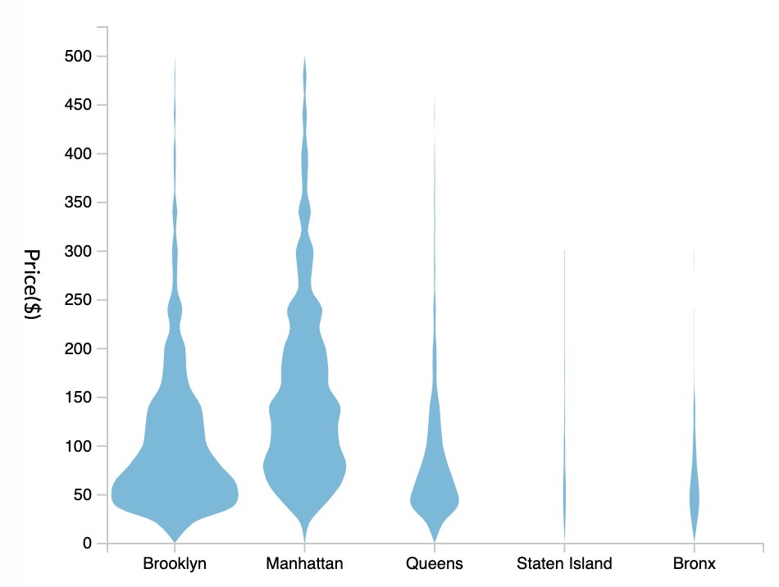
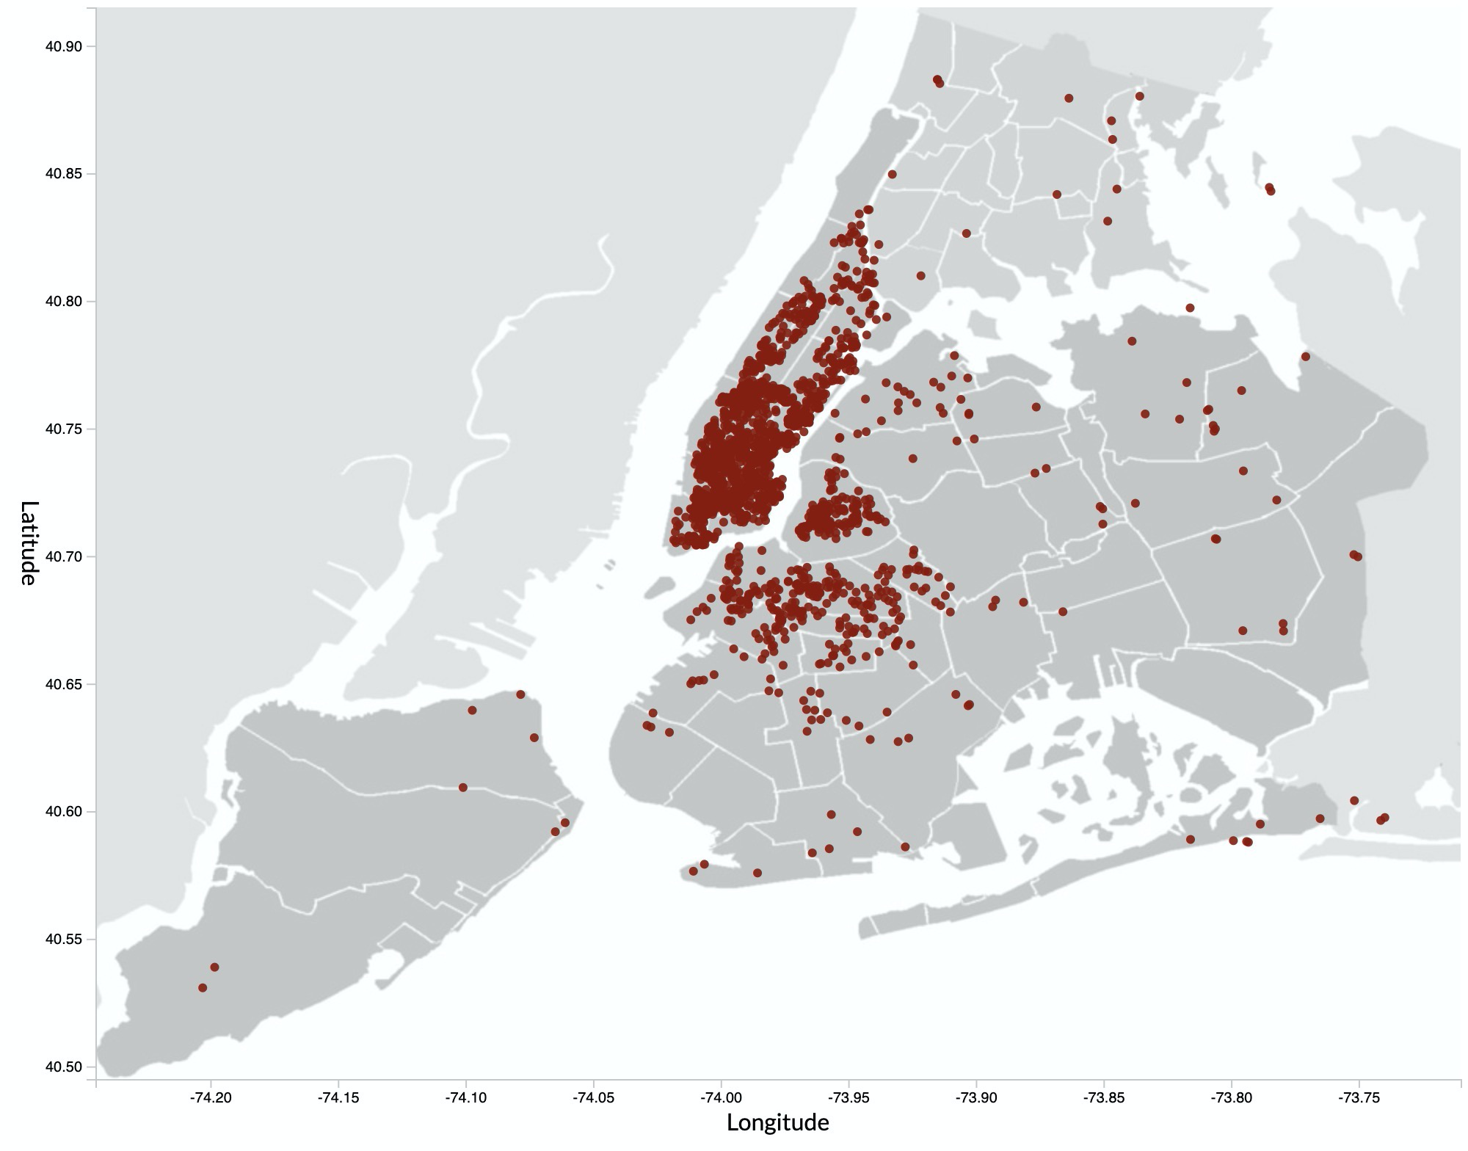
Price Distribution
Manhattan
Queens
Brooklyn
Violin plot of price distribution
Listings of more than $400/night
Manhattan is pricey!!
Notes:
1988 listings of more than $400/night

Slide 13
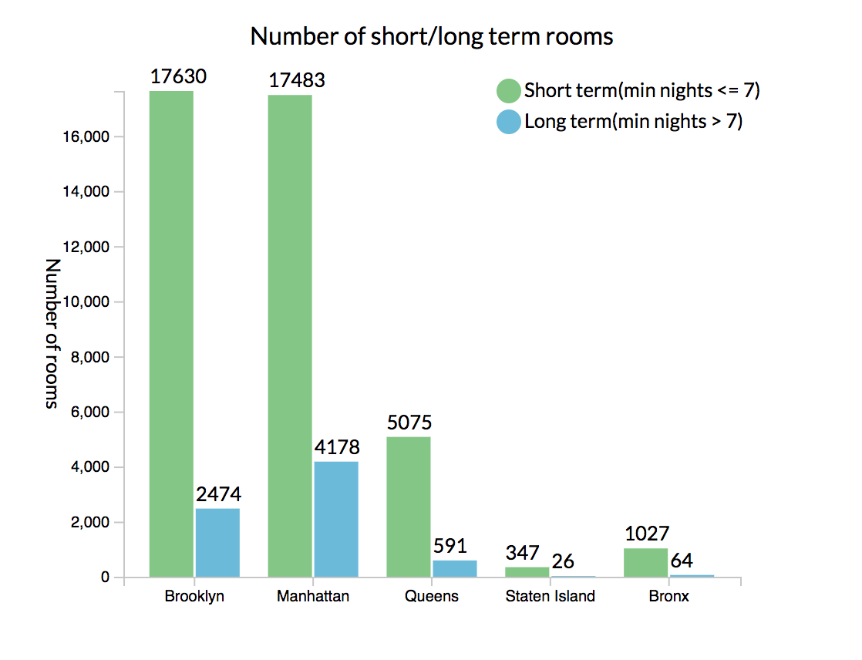
Short and long term rooms by Neighbourhood

Slide 14
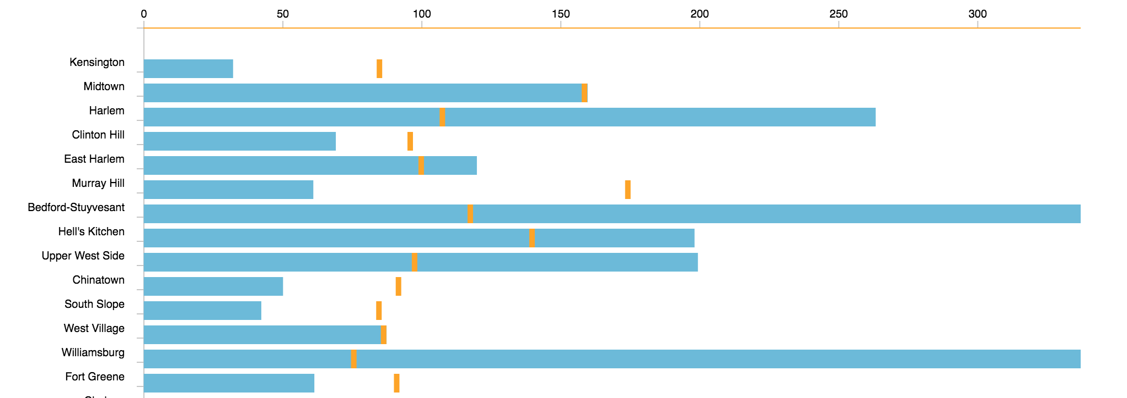

Neighbourhoods and their availability
Average available days/year
Airbnbs Available
Notes:
Williamsburg has the most rooms available: 3920
Stuyvesant is the second, following by Harlem

Slide 15
Demo
https://github.com/imyuanwen/nyc-airbnb
https://imyuanwen.github.io/nyc-airbnb/
We put our code, data and assets on a Github repository.
Use Github pages to present our prototype.
Notes:
Challenges:
Progressively display the data since the dataset is so big. The loading time is ok, but the speed of drawing all those circles is not so ideal.
A interactive map is better, if I can zoom in and zoom out. The density of the map make the tooltip on the map infeasible to.
The nonlinear distribution of the data make some visualizations look not so perfect.
The webpage is not friendly to mobile phone.

Slide 16

Summary of Contribution
Suchi
Rui
Eddie
Cody
Notes:
Each of us were in charge of one plot for our visualization.
Suchi: Suchi brought up the idea of this project at the first place. She also searched the data and created UI sketches for visualization tasks in tableau. She worked on the price distribution violin plot visualization. She was also instrumental in making sure we meet regularly and stay on course to finish our individual tasks for the project on time. (Feel free to edit)
Rui: there are 200 neighborhoods in total in the dataset, Rui is responsible for the visualization of the availability and popularity for the 200 neighborhoods. So she worked on the bar chart. Firstly, she calculated average available days in a year to show popularity; next, she calculated the number of rooms to showcase availability of every neighborhood.
Yuan: Made the main one, the Map, and filters. Integrated everyone’s code and added some css to make the webpage looks nicer.
Cody: Short term vs. Long term listing comparison

Slide 17
Conclusion & Lesson Learned
D3 & SimpleStats
Different visualizations for different data
(scatter plot, violin plot, bar chart)
Usability
Notes:
- we considered accessibility, to make our product accessible to different user groups.
- We also considered color blindness in our design.
- we designed the product from a user perspective to provide a smooth experience for the users.

Slide 18


